Slide 1
Two knowledge/research-centers financially backed by the Danish Ministery of Education,
which Mercantec is a part of.

Slide 2
Troels Nepper, Project manager at Mercantec
Carpenter / Bygningskonstruktør / Not a talented student – my motivation / Tech-geek / Mercantec / Knowledge centers: https://videnscenterportalen.dk/vihda/
https://videnscenterportalen.dk/arn/
Todays presentation will mainly focus on Augmented Reality, how easy it is to use, and how it raises the quality of a lectures or a courses.

Slide 3
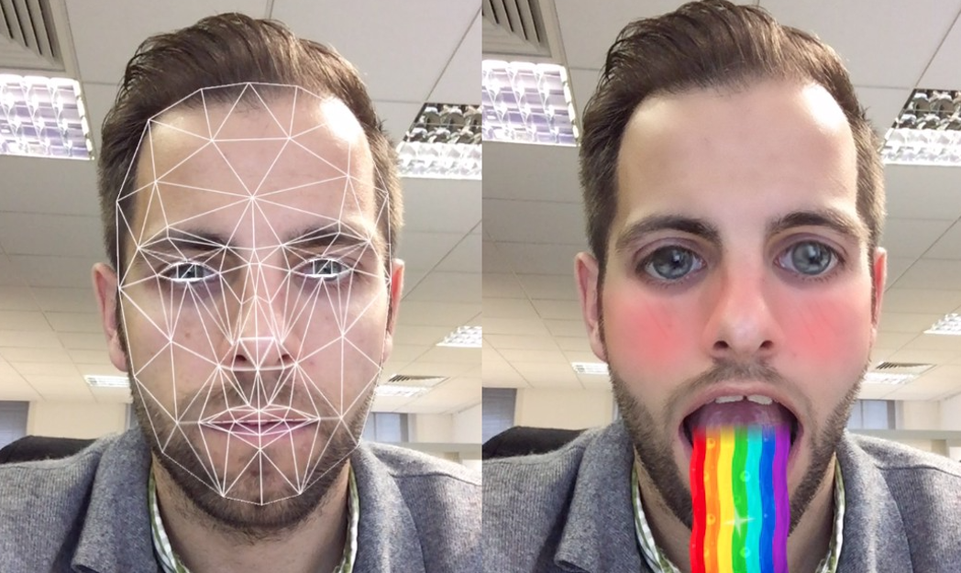
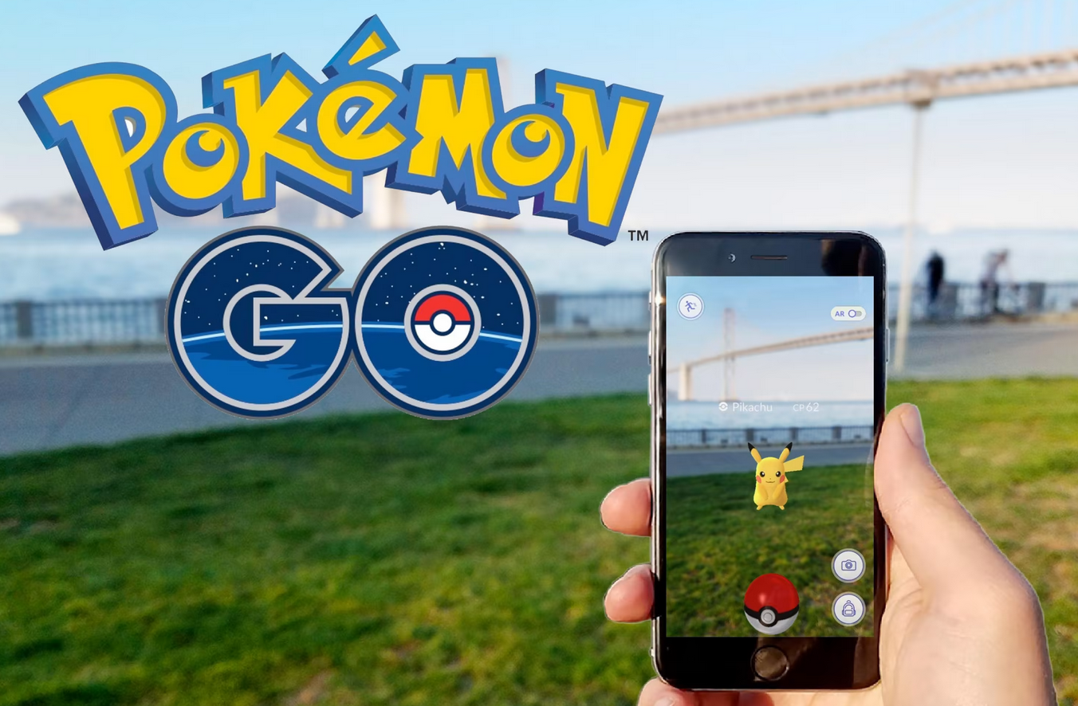
Understand the terms AR and VR
Augmented Reality (AR) = The vision you have with your eyes, combined with computer graphics. For exsample SnapChat filters or Pokemon Go.
Virtuel Reality (VR) is only computer graphics.

Slide 4
In which areas can AR be used with succes?
Students can ”quality control” their own work, beofre - You will see an example later
Get help without the presence of a teacher
Help students develop understanding of drawing / 3 Dimensional thinking - You will se an example later
As a tool for differentiation in the classroom
AR-Tours, example from 2018; https://youtu.be/z-3HsRK3VAA
Quality control or ”how to guide” for future installations or constructions
As an easy presentation tool for expensive hardware
And much more……

Slide 5
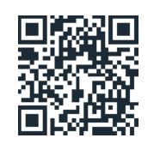
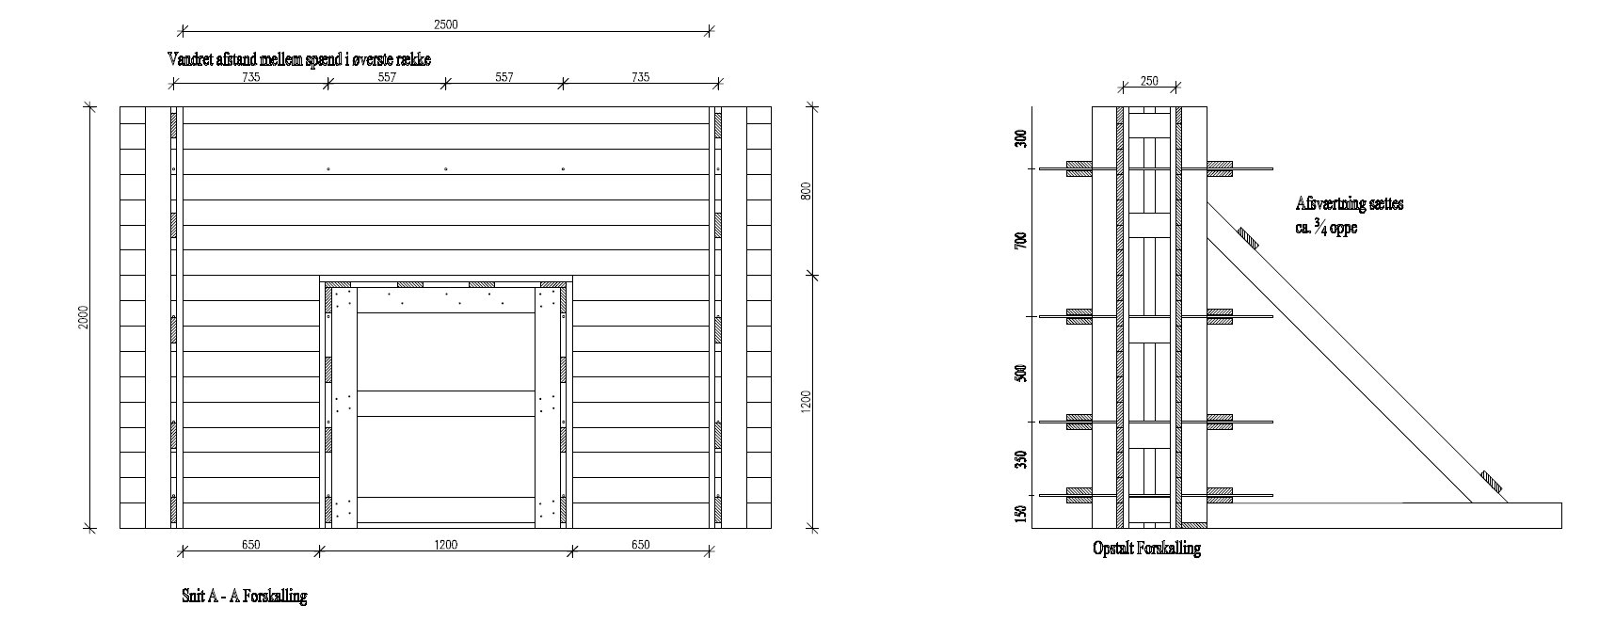
Proff of concept 1:
There is no need to design new courses, simply refresh your allraedy excisting asignments.

Slide 6
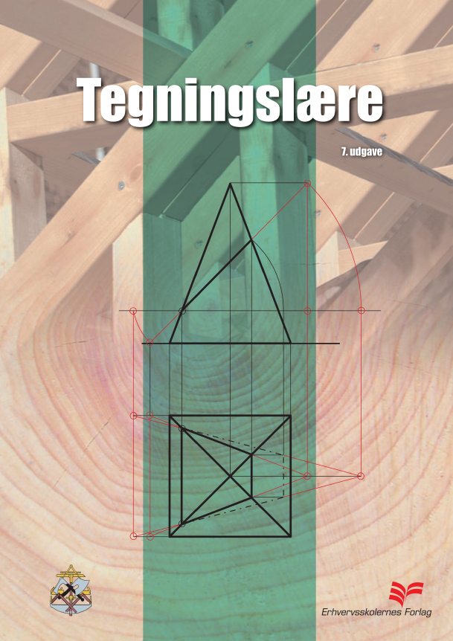
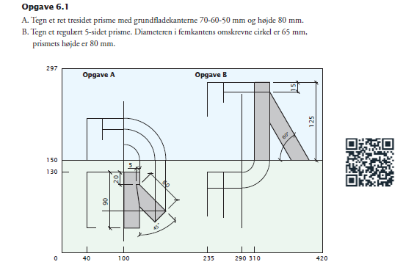
Proff of concept 2:
There is no need to design new courses, simply refresh your allraedy excisting asignments.

Slide 7
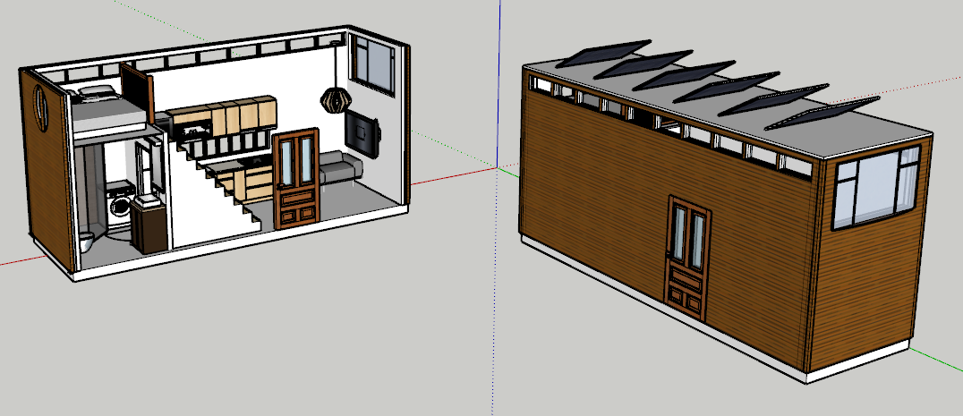
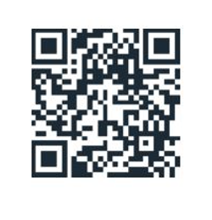
Proff of concept 3:
Tiny house concept from GF2 students. Does the design work in reality?

Slide 8
Whats next on my AR adventure?
In a joint venture between the two ”knowledge centers”, I am going to startup an Augmented Reality network between schools, developers and contractors. Our goal is to unite and share information, so everyone interested learns how to use the technology.
thne@mercantec.dk
+45 21727215

